Slide 1
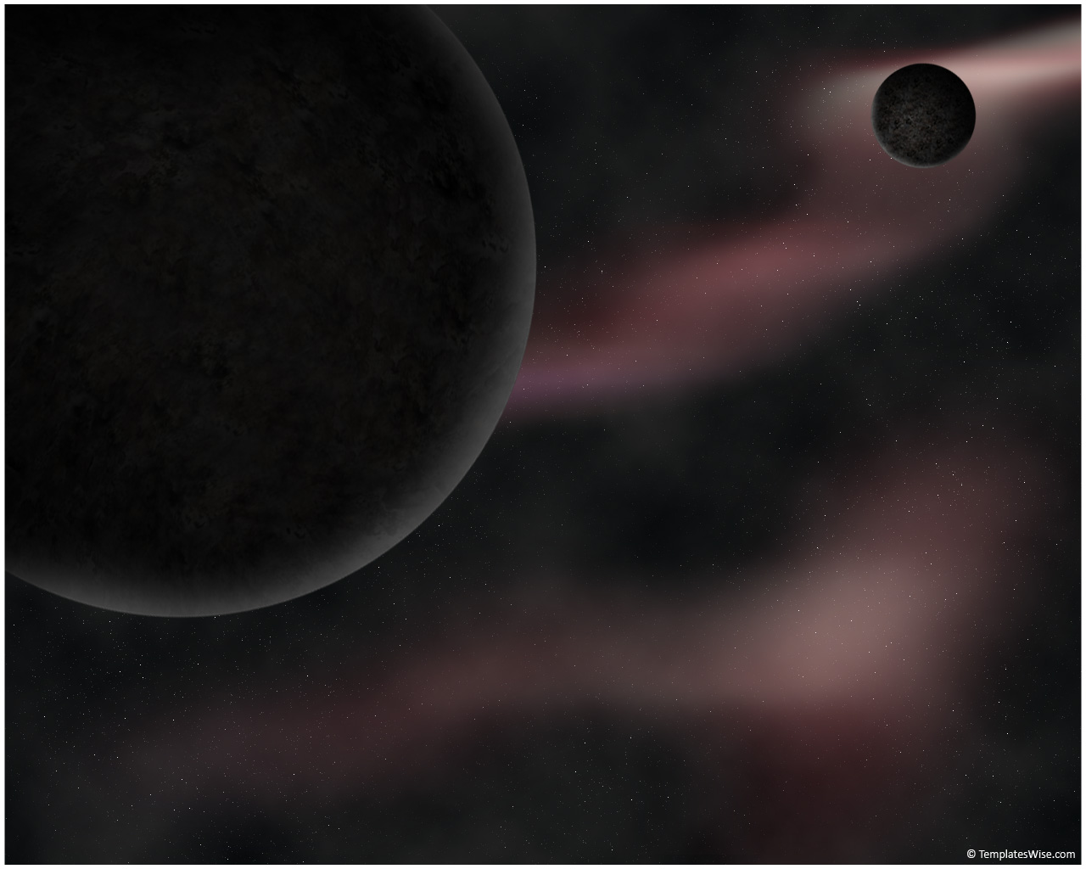
STAR SALADS
A long time ago, in a contest far, far away…

Slide 2




To Boldly Grow
We’re going to Mars!
But, it’s a long trip.
We’ll get hungry before we get there!
We also may dehydrate a bit.

Slide 3


To Boldly Grow
Problem: no McDonald’s around! ☹

Slide 4
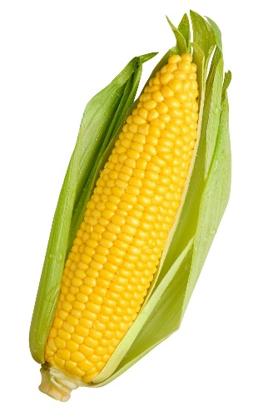
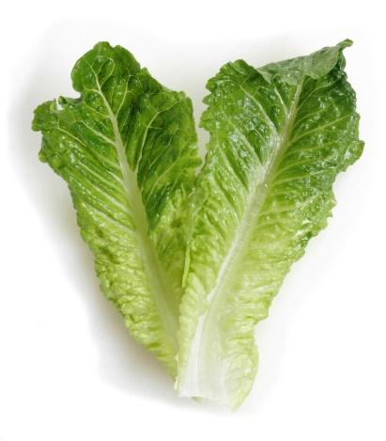
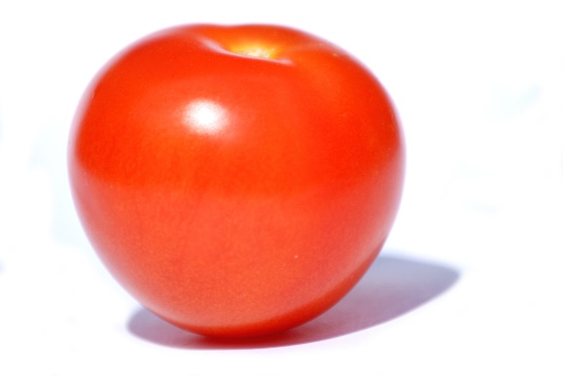
To Boldly Grow
Solution:
Grow our own food!
With lots to spare.
Don’t forget to keep breathing!

Slide 5

Hoooold It!

Slide 6

Isn’t Mars kinda… dangerous?
It has:
A temperature range from -153 C to 23 C
Constant wind at ~120 km/h
95% carbon dioxide atmosphere composition

Slide 7
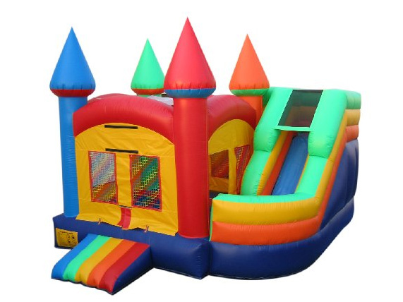

So… how do we do this, again?
We make glass houses!
Real fancy ones.
But, glass is heavy…
…and breaks a lot
So, how about balloons?

Slide 8
So… how do we do this, again?
We grow:
Grains, like oats and corn
Easy to grow and store
Full of proteins and minerals
Lasts forever
Salads, like lettuce and spinach
Tasty and packed with vitamins
Highly perishable
Not on Martian temperatures, though
Fruits, like apples and figs
Sweet and delicious
Loads of sugar and fibers
Plenty of water, too

Slide 9
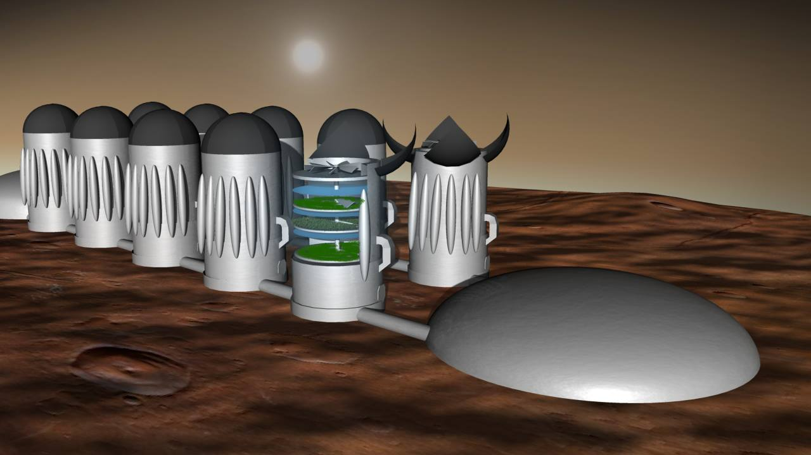

Slide 10
Bouncy Ball of Doom
It is
Inflatable
Light, and easy to transport
Indestructible
Space-grade NASA polymer
Ultra-thin, yet withstands pressures of 2 tons per cm sq.
And great at preserving heat!

Slide 11
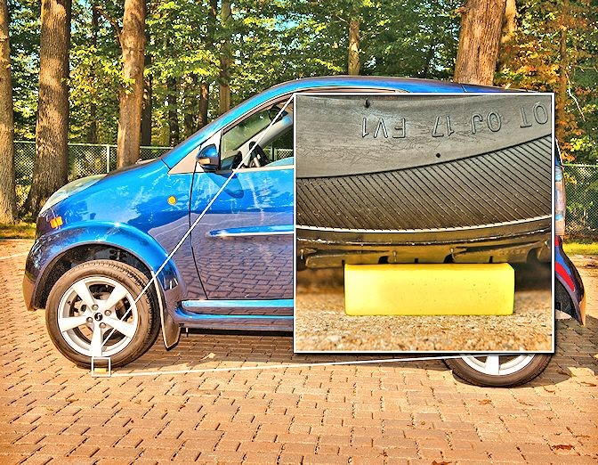

Slide 12

Powered by… electricity
Utilizes both solar and wind energies
Generates over 5,000 kilowatt hours
Per module!
Withstands winds of over 140 km/h!

Slide 13
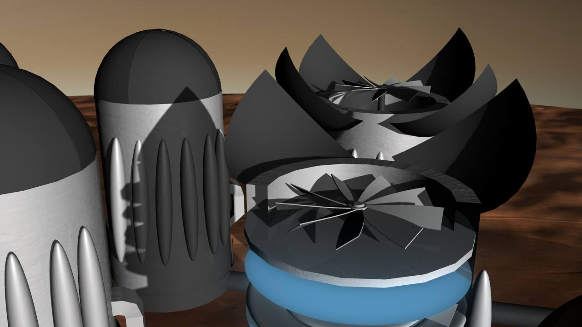

Slide 14
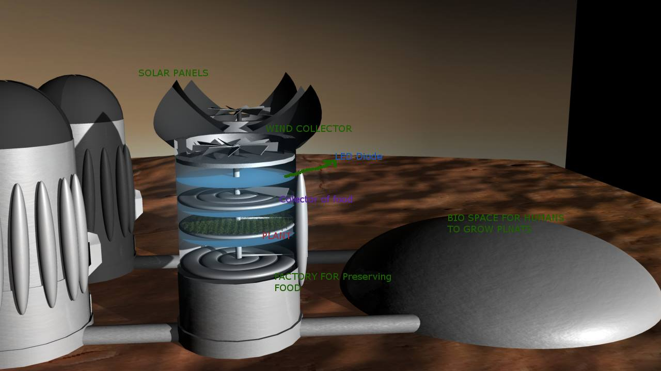

Slide 15


Slide 16


